Slide 1
Capability Maturity Model

Slide 2
What is CMM?
CMM: Capability Maturity Model
Developed by the Software Engineering Institute of the Carnegie Mellon University
Framework that describes the key elements of an effective software process.

Slide 3
What is CMM?
Describes an evolutionary improvement path for software organizations from an ad hoc, immature process to a mature, disciplined one.
Provides guidance on how to gain control of processes for developing and maintaining software and how to evolve toward a culture of software engineering and management excellence.

Slide 4
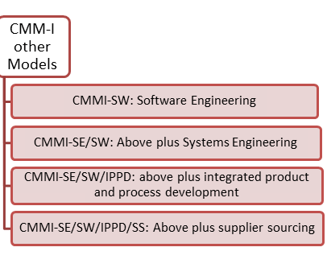

Slide 5
Process Maturity Concepts
Software Process
set of activities, methods, practices, and transformations that people use to develop and maintain software and the associated products (e.g., project plans, design documents, code, test cases, user manuals)
Software Process Capability
describes the range of expected results that can be achieved by following a software process
means of predicting the most likely outcomes to be expected from the next software project the organization undertakes

Slide 6
Process Maturity Concepts
Software Process Performance
actual results achieved by following a software process
Software Process Maturity
extent to which a specific process is explicitly defined, managed, measured, controlled and effective
implies potential growth in capability
indicates richness of process and consistency with which it is applied in projects throughout the organization

Slide 7
What are the CMM Levels? (The five levels of software process maturity)
Maturity level indicates level of process capability:
Initial
Repeatable
Defined
Managed
Optimizing

Slide 8
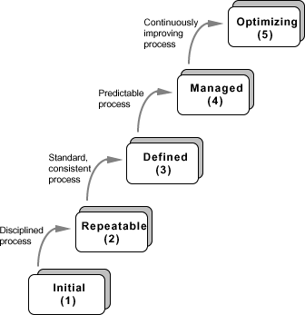

Slide 9
Level 1: Initial
Initial : The software process is characterized as ad hoc, and occasionally even chaotic. Few processes are defined, and success depends on individual effort.
At this level, frequently have difficulty making commitments that the staff can meet with an orderly process
Products developed are often over budget and schedule
Wide variations in cost, schedule, functionality and quality targets
Capability is a characteristic of the individuals, not of the organization

Slide 10
Level 2: Repeatable
Basic process management processes are established to track cost, schedule, and functionality. The necessary process discipline is in place to repeat earlier successes on projects with similar applications.
Realistic project commitments based on results observed on previous projects
Software project standards are defined and faithfully followed
Processes may differ between projects
Process is disciplined
earlier successes can be repeated

Slide 11
Level 3: Defined
The software process for both management and engineering activities is documented, standardized, and integrated into a standard software process for the organization. All projects use an approved, tailored version of the organization’s standard software process for developing an maintaining software.

Slide 12
Level 4: Managed
Detailed measures of the software process and product quality are collected. Both the software process and products are quantitatively understood and controlled.
Narrowing the variation in process performance to fall within acceptable quantitative bounds
When known limits are exceeded, corrective action can be taken
Quantifiable and predictable
predict trends in process and product quality

Slide 13
Level 5: Optimizing
Continuous process improvement is enabled by quantitative feedback from the process and from piloting innovative ideas and technologies.
Goal is to prevent the occurrence of defects
Causal analysis
Data on process effectiveness used for cost benefit analysis of new technologies and proposed process changes

Slide 14
Internal Structure to Maturity Levels
Except for level 1, each level is decomposed into key process areas (KPA)
Each KPA identifies a cluster of related activities that, when performed collectively, achieve a set of goals considered important for enhancing software capability.
commitment
ability
activity
measurement
verification

Slide 15
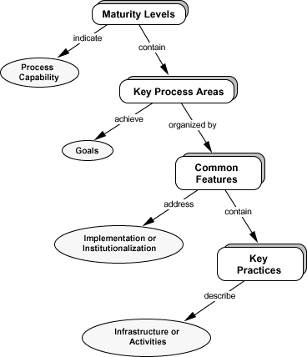

Slide 16
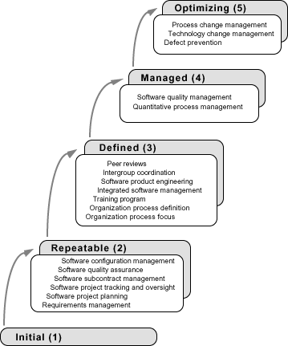

Slide 17
Level 2 KPAs
Requirements Management
Establish common understanding of customer requirements between the customer and the software project
Requirements is basis for planning and managing the software project
Not working backwards from a given release date!
Software Project Planning
Establish reasonable plans for performing the software engineering activities and for managing the software project

Slide 18
Level 2 KPAs
Software Project Tracking and Oversight
Establish adequate visibility into actual progress
Take effective actions when project’s performance deviates significantly from planned
Software Subcontract Management
Manage projects outsourced to subcontractors
Software Quality Assurance
Provide management with appropriate visibility into
process being used by the software projects
work products

Slide 19
Level 2 KPAs
Software Configuration Management
Establish and maintain the integrity of work products
Product baseline
Baseline authority

Slide 20
Level 3 KPAs
Organization Process Focus
Establish organizational responsibility for software process activities that improve the organization’s overall software process capability
Organization Process Definition
Develop and maintain a usable set of software process assets
stable foundation that can be institutionalized
basis for defining meaningful data for quantitative process management

Slide 21
Level 3 KPAs
Training Program
Develop skills and knowledge so that individual can perform their roles effectively and efficiently
Organizational responsibility
Needs identified by project
Integrated Software Management
Integrated engineering and management activities
Engineering and management processes are tailored from the organizational standard processes
Tailoring based on business environment and project needs

Slide 22
Level 3 KPAs
Software Product Engineering
technical activities of the project are well defined (SDLC)
correct, consistent work products
Intergroup Coordination
Software engineering groups participate actively with other groups
Peer Reviews
early defect detection and removal
better understanding of the products
implemented with inspections, walkthroughs, etc

Slide 23
Level 4 KPAs
Quantitative Process Management
control process performance quantitatively
actual results from following a software process
focus on identifying and correcting special causes of variation with respect to a baseline process
Software Quality Management
quantitative understanding of software quality
products
process

Slide 24
Level 5 KPAs
Process Change Management
continuous process improvement to improve quality, increase productivity, decrease cycle time
Technology Change Management
identify and transfer beneficial new technologies
tools
methods
processes
Defect Prevention
causal analysis of defects to prevent recurrence

Slide 25
What are the benefits ?
Helps forge a shared vision of what software process improvement means for the organization
Defines set of priorities for addressing software problems
Supports measurement of process by providing framework for performing reliable and consistent appraisals
Provides framework for consistency of processes and product

Slide 26
Why measure software and software process?
Obtain data that helps us to better control
schedule
cost
quality of software products

Slide 27
Consistent measurement provide data for:
Quantitatively expressing requirements, goals, and acceptance criteria
Monitoring progress and anticipating problems
Quantifying tradeoffs used in allocating resources
Predicting schedule, cost and quality

Slide 28
Measurements
Historical
Plan
Actual
Projections

Slide 29
SEI Core Measures

Slide 30
Examples of measurements for size of work products
Estimated number of requirements
Actual number of requirements
Estimated source lines of code (SLOC)
Actual SLOC
Estimated number of test cases
Actual number of test cases

Slide 31
Example of measurements of effort
Estimated man-hours to design/code a given module
Actual man-hours expended for designing/coding the module
Estimated number of hours to run builds for a given release
Actual number of hours spent running builds for the release

Slide 32
Examples of measurements of quality of the work product
Number of issues raised at requirements inspection
Number of requirements issues open
Number of requirements issues closed
Number of issues raised during code inspection
Number of defects opened during unit testing

Slide 33
Examples of measurements of quality of the work product
Number of defects opened during system testing
Number of defects opened during UAT
Number of defects still open
Number of defects closed
Defect age

Slide 34
Examples of measurements of quality of the work product
Total number of build failures
Total number of defects fixed for a given release
Total number of defects verified and accepted
Total number of defects verified and rejected

